Slide 1
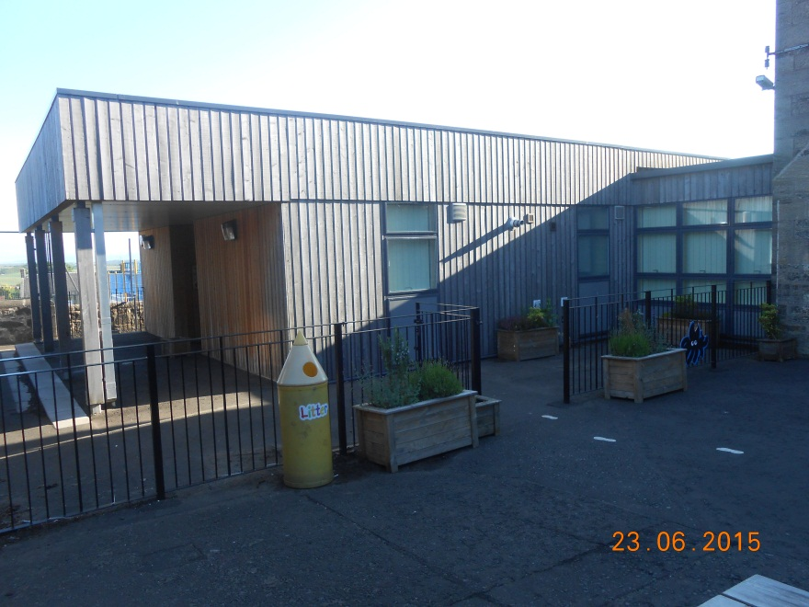
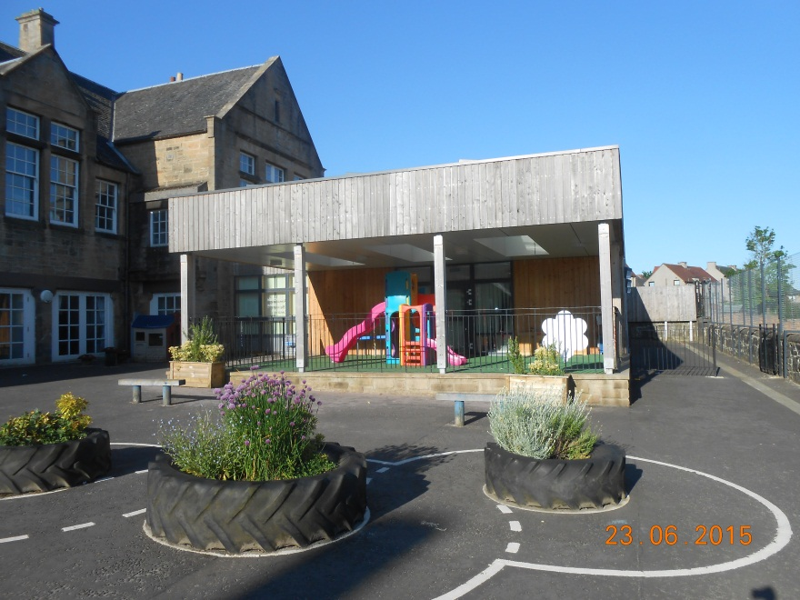
Welcome to Armadale Primary School
Starting Nursery

Slide 2
ELC Staff
Up to 120 children – mix of AM, PM and Full Day Places.
Mrs Ross, Head Teacher (Seconded) and Mrs Drummond, Acting Depute Head Teacher
Ms Philip, Principal Teacher (Early Years) and Mrs Brown, Early Years Officer
Our Nursery team - Early Years Practitioners and Pupil Support Workers. (Staff photographs will be up in the children’s cloakroom, at the entrance to the nursery.)
Each child is allocated a member of staff as a key worker who has responsibility for monitoring the education, care and well-being of your child. (Observations)

Slide 3
First Day
Individual plan
We generally recommend:
Day 1 – 1 hour.
Day 2 – 2 hours.
Day 3 – Full session
Staff happy to take time each child needs,
If your child is particularly upset or is not settling don’t worry, we will give you a ring about 15-20 minutes into the session if you would like us to.

Slide 4
Nursery Hours
Morning Session:
Monday – Friday: 8.00am– 11.08am
Afternoon Session
Monday – Thursday: 12.10am – 4.07pm
Full Day Session
2 Allocated Days: 8am – 6.00pm

Slide 5
Attendance
Regular attendance at the nursery is important to develop the children’s skills, routines and development.
In line with West Lothian Council Policy – Safe Arrivals Procedure
Absences – contact before 9am/12.30pm

Slide 6
Entering the Nursery
If you bring or collect children by car, please do not enter our school car parks. In the interest of safety, it strictly out of bounds for parents to park in or walk through the car park with their children.
Please press the buzzer to gain access to the nursery. (We kindly ask that you close ALL gates and doors behind you.)
Please ensure your child has registered with a member of staff and is settled in the nursery before leaving the building

Slide 7
Leaving the nursery
To make the nursery a secure place for children, there is a secure entry system in place.
You will be asked to provide contact details of two main people who can collect your child. Your child will not be entrusted to a person not known to the nursery staff.
Every child must be collected from the nursery by a named adult who must be over 16 years of age.
It is your responsibility to inform the nursery of any alternative arrangements for the collection of your child.

Slide 8
What happens if they are ill or upset?
We kindly ask, if your child has a sickness or infectious illness that you allow 48 hours after the symptoms disappear before returning to the nursery to stop the spread of infection.
If your child requires medicine to be administered at the nursery you will be asked to sign a Medication Consent Form.
If your child becomes ill during their time at the nursery, we will contact you.

Slide 9
Clothing
We encourage self-care and independence:
Comfortable play clothes which are easily fastened and unfastened.
(Nursery Sweatshirts, T-shirts and Jackets with our nursery logo can be ordered from the school office. Wearing a nursery uniform is not compulsory however nursery can be messy and we strongly recommend children do not wear their best clothes. )
A pair of velcro or elastic fastening plimsolls to wear indoors.
(The nursery staff will write your child’s name on the front and provide a gym bag to keep them in.)
We provide: jacket, wellingtons, hat and gloves for outdoor play
On sunny days please ensure your child has sun hat, sunscreen etc.

Slide 10
Healthy Lifestyles
Daily Snack
Planned weekly/pupil choice. £1.50
Healthy Lunches
Packed Lunch/School Lunch. £2.04
Tooth brushing - Scottish Government Childsmile Programme.
Toileting independently
Staff support at child’s pace
Change of clothes

Slide 11
Nursery Curriculum
Curriculum for Excellence for all young children and young people from 3-18.
Health & Wellbeing
Literacy and English
Numeracy and Mathematics
Social Studies
Technologies
Science
Expressive Arts
Religious Education

Slide 12
Consultative Planning
Pupil involvement & ownership
Possible lines of development
Reviewed regularly with pupils
Staff guide – curriculum, key developmental milestones and observational assessment

Slide 13
Online Learners Journal
The nursery staff record you child’s interests and learning within a Floorbook
Online Learners Journal to share learning with you which you can access, anytime that suits, through a secure server.
The Children’s Learning Journals will contain staff observations of your child, your child’s quotes, photographs and examples of your child’s art work.
You are welcome to contribute your comments on your child’s interests and learning in the nursery and any achievements from home.

Slide 14
Working in Partnership with parents
There are lots of ways you can get involved in the nursery including:
Becoming a parent helper
Attending our ‘LEAPS’ coffee mornings
Visiting our Stay, Play & Learn Sessions
Contributing to our ‘Home & Away’ wall display.
More information is available within our newsletters, website or displayed on the parents notice board.

Slide 15
Keeping up to date
There are lots of ways we try to keep parents and carers up to date with events in our nursery.
Newsletters
Chalk board at door
Notice Board
Website: https://armadaleprimary.westlothian.org.uk/
Twitter: ArmadalePrimaryELC @ElcPrimary
Information screen in cloakroom (coming soon!)

Slide 16
Child Protection
Confidentiality
All parent and carer discussions are treated in the strictest confidence. Information is only shared amongst other appropriate staff with the permission of the individual parent/carer concerned, except information relating to child protection issues.
Child Protection
As part of our commitment to pupil safety and well-being the nursery follows the Child Protection Guidelines outlined in the Edinburgh and Lothians Inter Agency Child Protection Procedures. Please contact the Head Teacher if you would like to see these guidelines.

Slide 17
We have an open door policy!
Please feel free to discuss any concerns or queries with the Early Years Officer, Principal Teacher or indeed the Head Teacher or Depute Head Teacher.
Our door is always open!

Slide 18
Induction Pack
Fill in details & leave:
Enrolment Form
‘Getting to know you’ Information Sheet
Allergens info
Emergency Treatment Consent Form
Online Learning Journal Consent Form
Photograph Consent
Adults who may collect
(only if needed)
Take home for info:
Armadale Primary School ELC Handbook
Tooth brushing /Child Smile info
Holiday Dates
Parent Council Invite
SALT Information Leaflet
Sharing from Home leaflet
Take home , complete & return:
All About Me
Uniform order

